Slide 1


Internship Project Presentation :
Acquisition system for magnetic sensors
GOUILA Bastien
20/06/2016
1

Slide 2
Table of contents
Short company presentation
I. Introduction
II. Acquisition Board
III. Acquisition Control
IV. AutoTests/FPGA Interface
V. Conclusion
20/06/2016
2

Slide 3
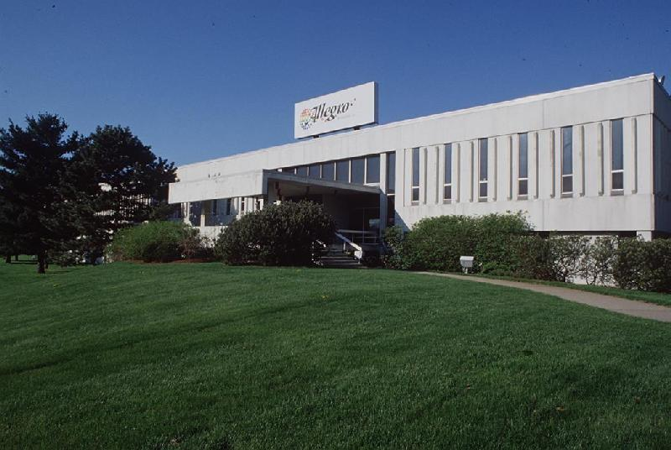
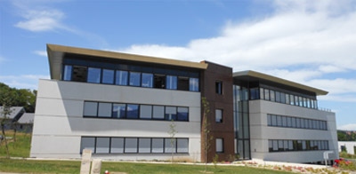
Short company presentation
American semiconductors company
Products type : -motor drivers
- DC/DC regulators
- magnetic sensors : speed & direction, position, current, linear, angular
Markets : -automotive
-consumer electronics
-industrial
Annecy technical center :
Focusing on magnetic sensors
Supporting new products development
Supporting the European customers
20/06/2016
3

Slide 4
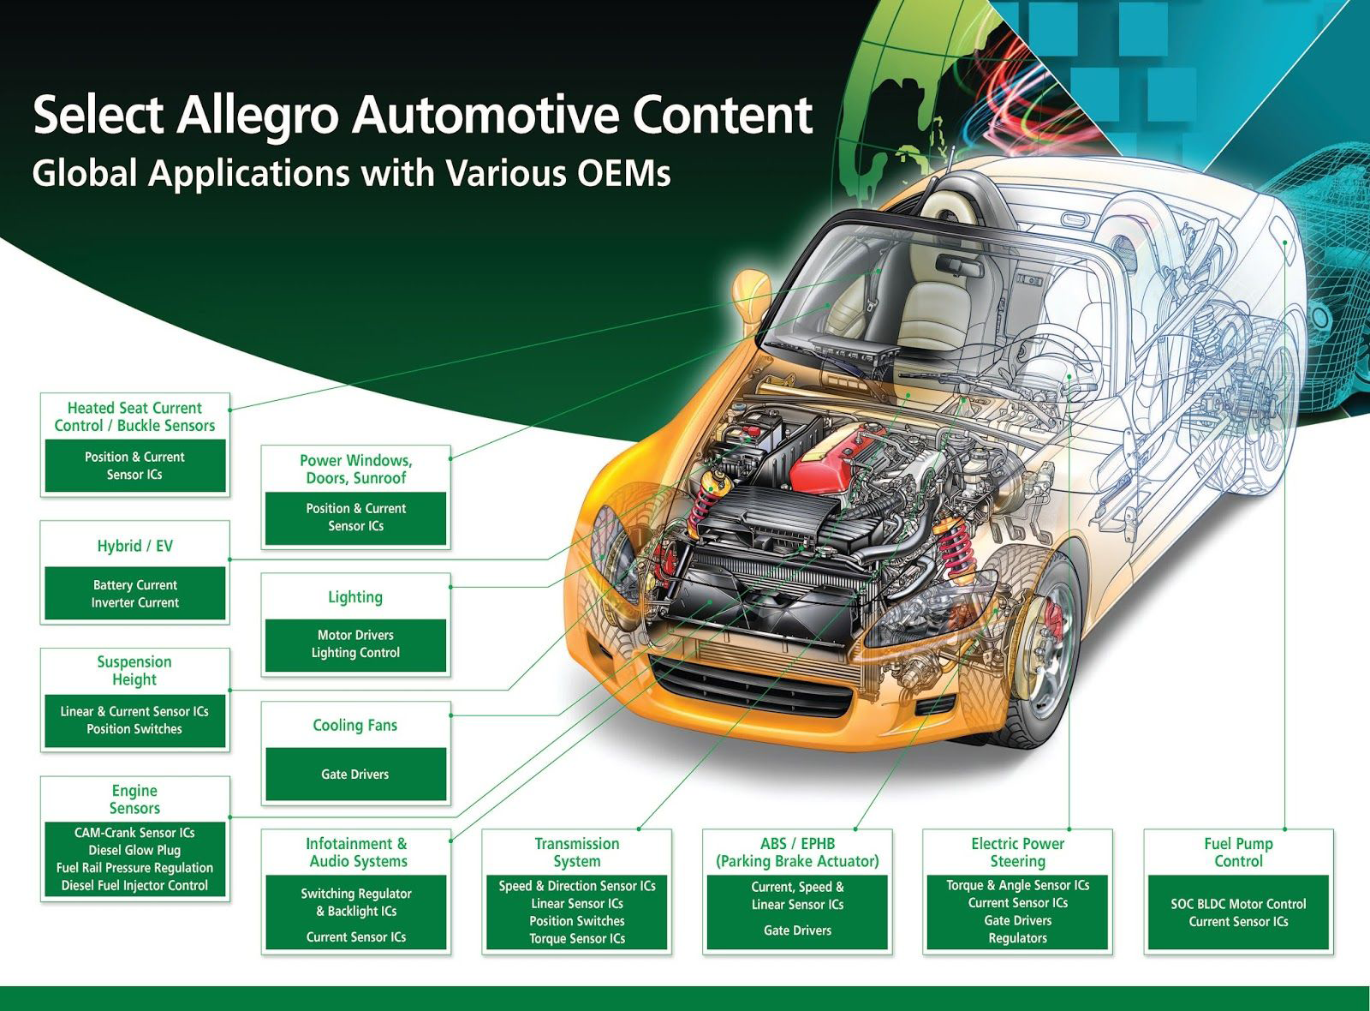
Short company presentation
20/06/2016
4

Slide 5
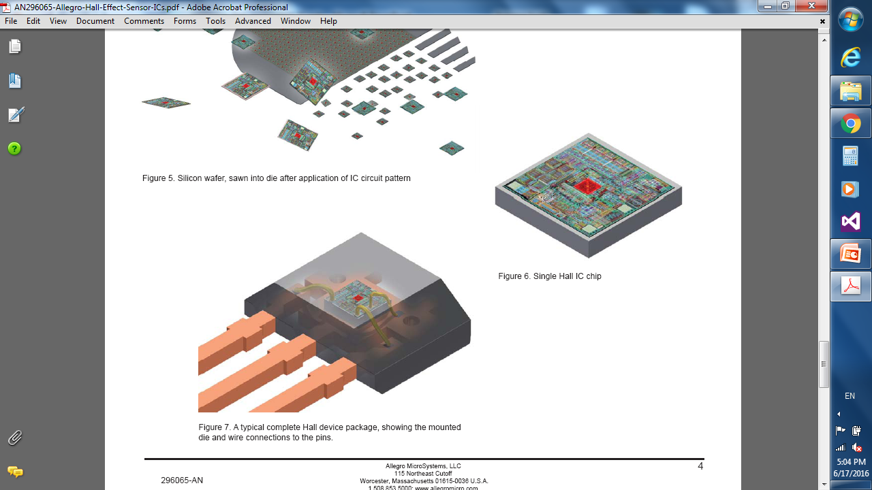
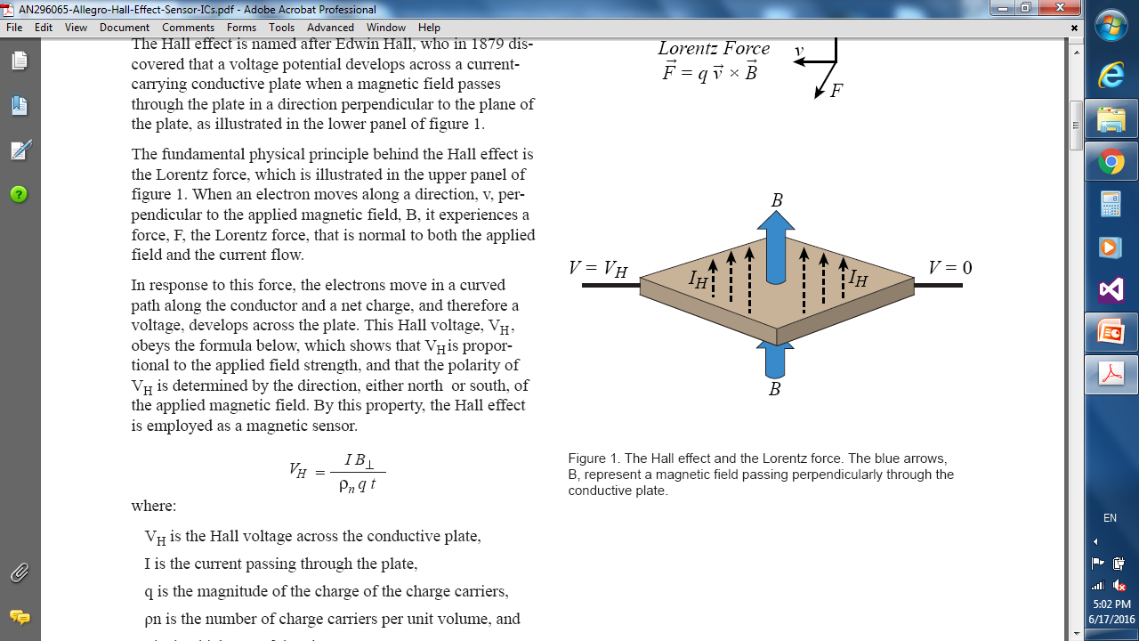
I. Introduction
Hall effect technology
20/06/2016
7
Notes:
Fleches : hall plate + IC
Qu est ce qu une hall plate ?
Hall plate = semiconducteur on applique un courant aux bornes de la hall plate et on obtient une tension proportionnel au champ perpendiculaire
Hall plate integrée

Slide 6
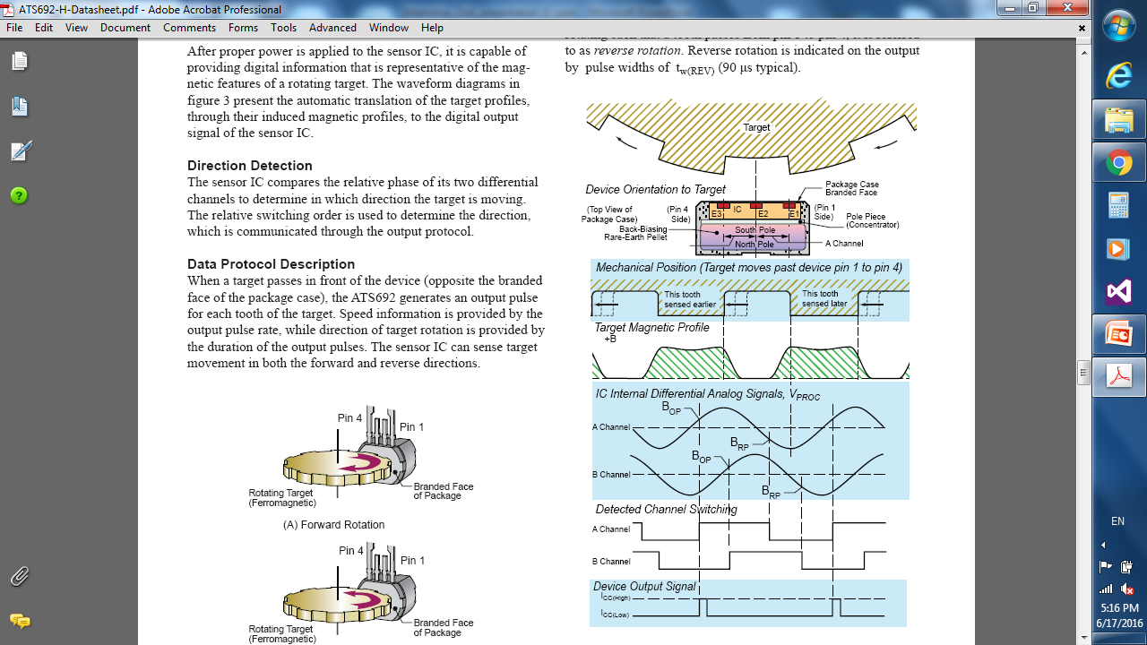
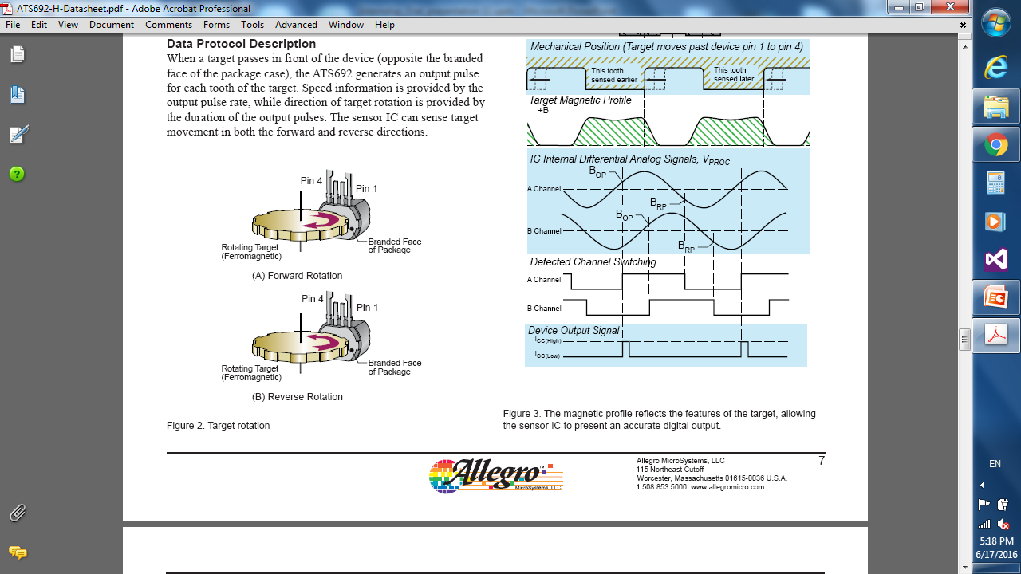
I. Introduction
Speed sensors
20/06/2016
7
Notes:
Ajouter le type de capteur + example cible et signal

Slide 7
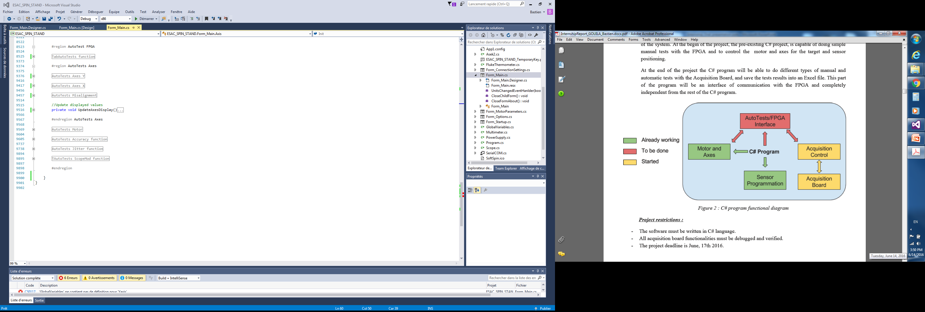
I. Introduction
Objectives :
Continue and complete the C# program
Carry out manual and automatic tests
Acquisition Control is independent
Save tests results into an Excel file
Project Framework:
Deadline : June, 17th 2016
Debug Acquisition Board
Continue the pre-existing project
Skills involved : electronic, computing
20/06/2016
6

Slide 8
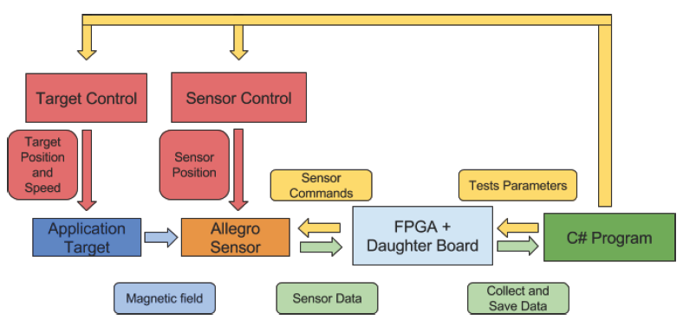
I. Introduction
Purpose of this project : Implement a solution to carry out manual and automatic tests on magnetic sensors
20/06/2016
5

Slide 9
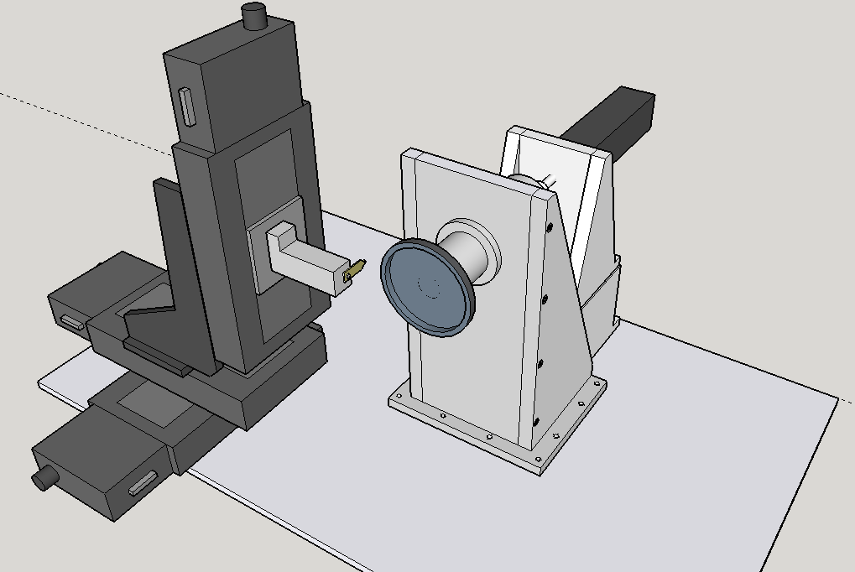
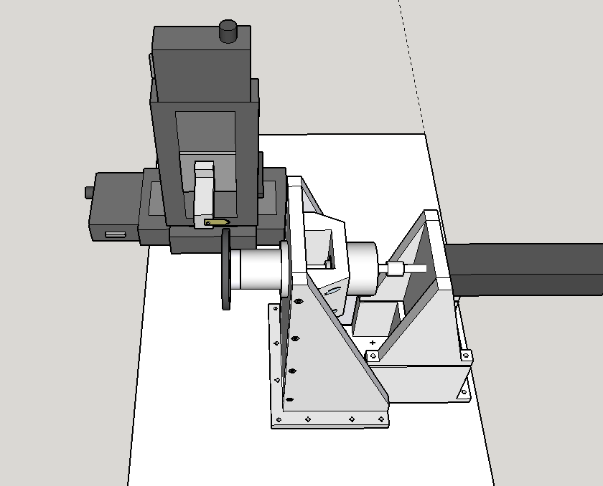
II. Acquisition Board
20/06/2016
8
Notes:
fleches

Slide 10
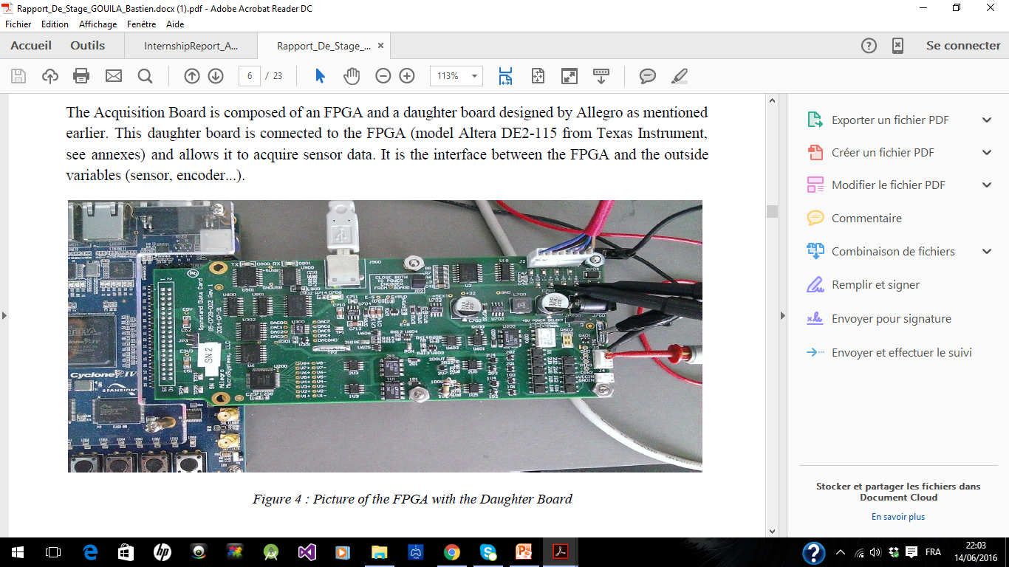
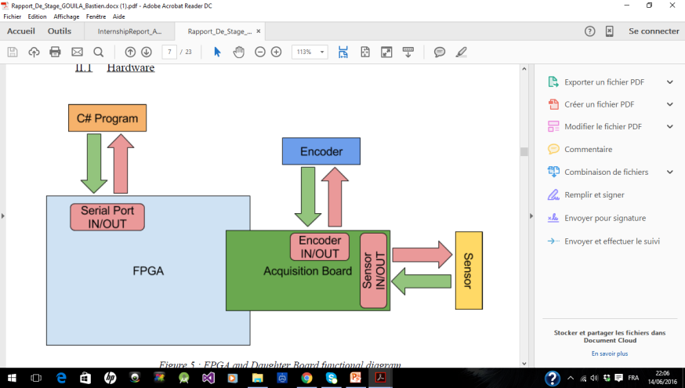
II. Acquisition Board
Acquisition Board = FPGA + Allegro daughter board
20/06/2016
9
Notes:
Fleches
Mentionner chaque bloc
Préciser FPGA

Slide 11
II. Acquisition Board
Tension et courant d’alimentation configurables
Entrées du capteur configurables
4 types de mesure simultanées disponibles
Ecriture/Lecture dans le FPGA
Paramètres de tests multiples
Alimentation et utilisation de l’encoder
20/06/2016
11

Slide 12
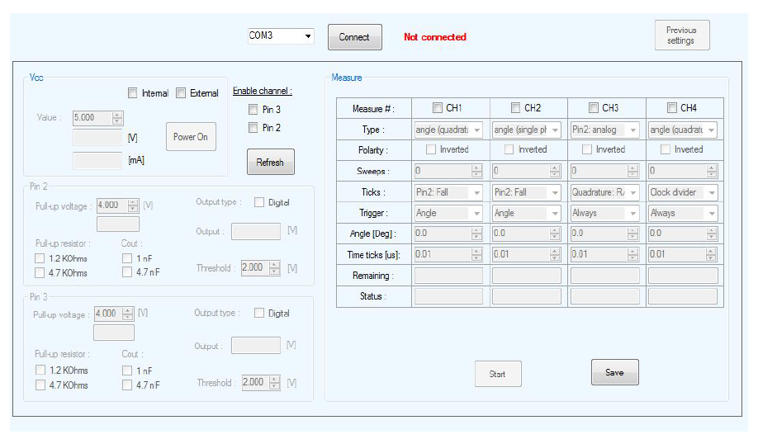
III. Acquisition Control
20/06/2016
12

Slide 13
III. Acquisition Control
20/06/2016
12

Slide 14
III. Acquisition Control
20/06/2016
12

Slide 15
III. Acquisition Control
20/06/2016
12

Slide 16
III. Acquisition Control
20/06/2016
12

Slide 17
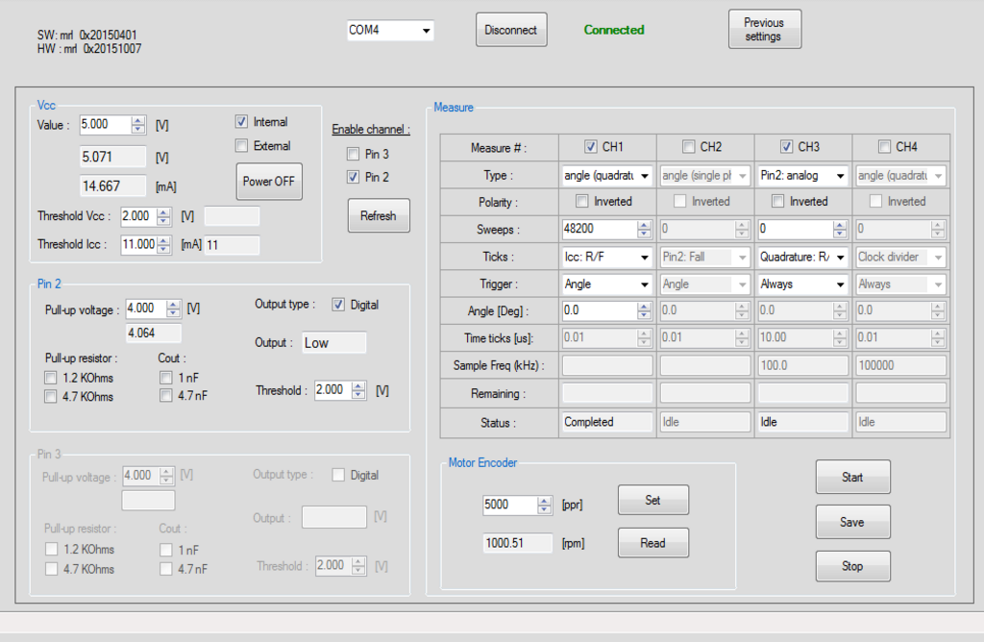
III. Acquisition Control
20/06/2016
13

Slide 18
III. Acquisition Control
20/06/2016
13

Slide 19
III. Acquisition Control
20/06/2016
13

Slide 20
III. Acquisition Control
20/06/2016
13

Slide 21
III. Acquisition Control
20/06/2016
13

Slide 22
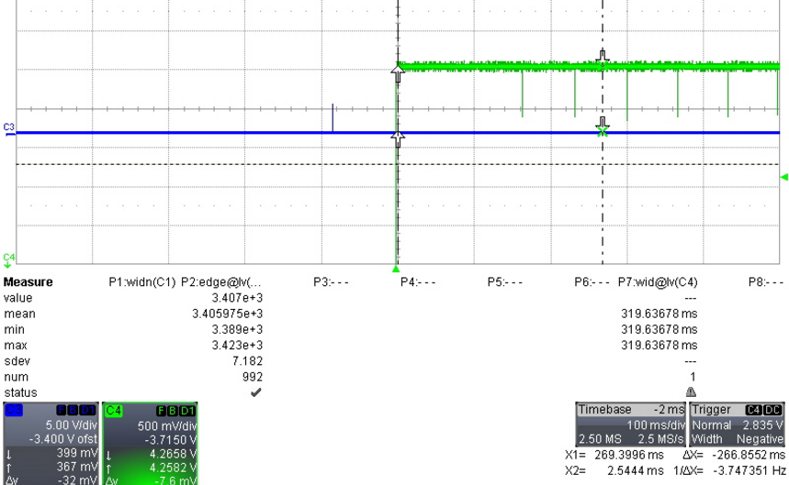
III. Acquisition Control
Startup Accuracy Test :
Power On < t < 1er signal du capteur
Test sur plusieurs cycles de Power On
= moyenne
2 possibilités d’utilisation :
“Air Gap effect”
“Speed effect”
tmax
Angle mesuré
20/06/2016
14
Notes:
Physiquement
Fleches signaux record angle

Slide 23
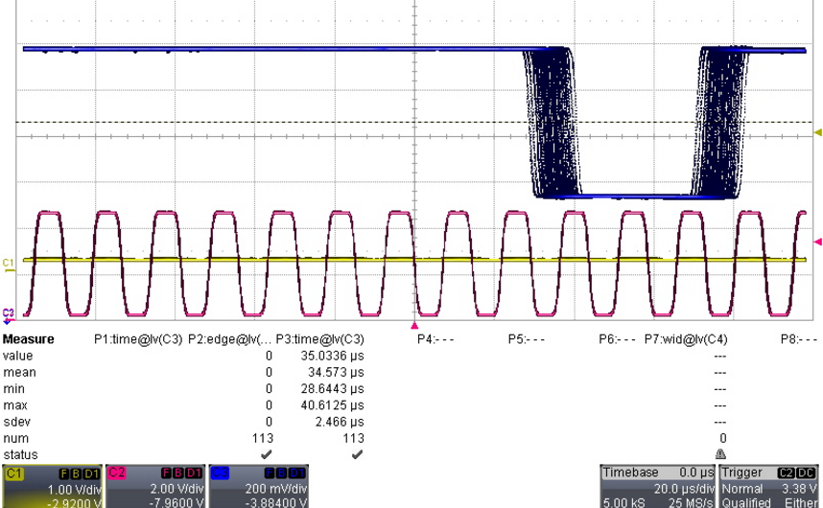
III. Acquisition Control
Jitter Test :
Jitter = variations du point de commutation dues aux bruits et fluctuations magnétiques et électriques
Système parfait = 0 Jitter
Distribution mathématique
= écart-type
= dispersion angulaire
Même front sur plusieurs révolutions
20/06/2016
15
Notes:
Mesure manuel pour l instant
Interet creation de ce systeme

Slide 24
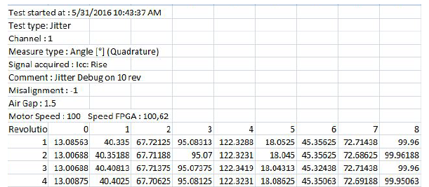
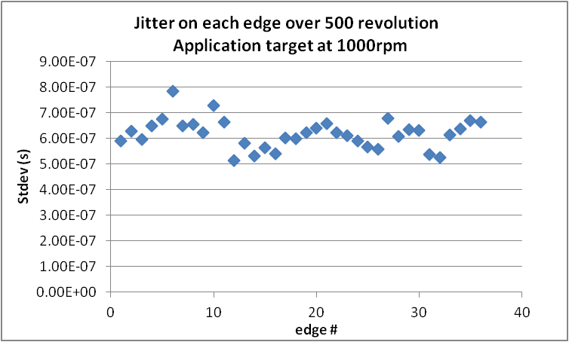
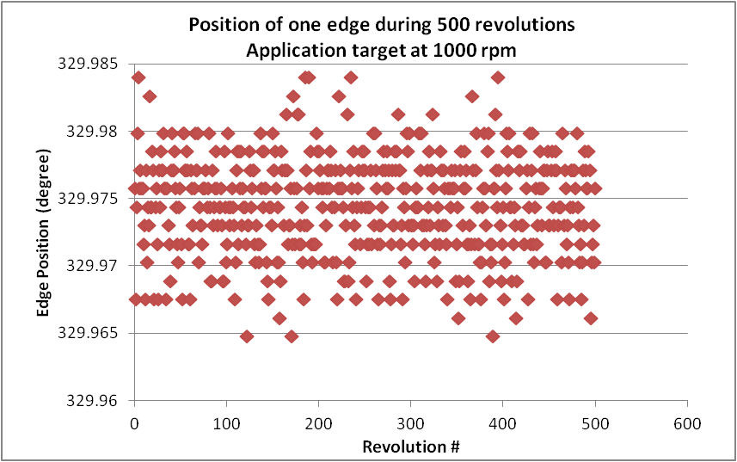
Ex : Test de Jitter
20/06/2016
23

Slide 25
III. Acquisition Control
Fonctions principales :
public void Multiple_Acqui_Measur_Start(uint uiCurrentCycleNbr)
public double [,] DataCollection(uint uiTotalNumberOfCycle, uint uiChannel)
public void Jitter( uint uiChannel)
public void StartupAccuracy(uint iNbPowerON, bool bPowerONType, int iAngleStartup, double dAngleStepSize, uint uiChannel)
public void StopTest(void)
public uint SaveDataToExcelFile(Excel.Worksheet xlWorkSheet, int iStartLine, int iStartColumn, string strComment, double [,] dTabAllData, string strTestType, uint uiChannel, …)
20/06/2016
16

Slide 26
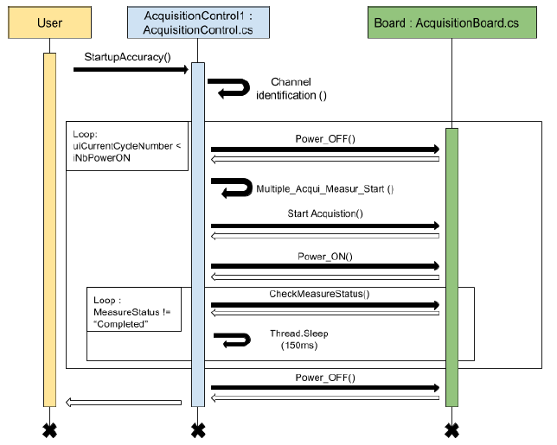
III. Acquisition Control
20/06/2016
17
Notes:
Parametres

Slide 27
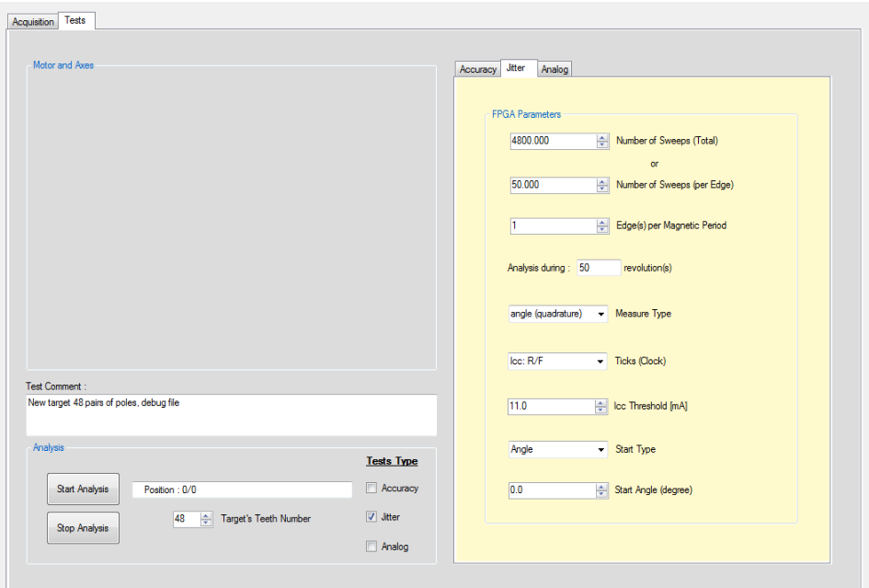
IV. AutoTests/FPGA Interface
20/06/2016
18

Slide 28
IV. AutoTests/FPGA Interface
Acquisition Control
20/06/2016
18

Slide 29
IV. AutoTests/FPGA Interface
Paramètres de tests spécifiques
20/06/2016
18

Slide 30
IV. AutoTests/FPGA Interface
Commandes de tests
20/06/2016
18

Slide 31
IV. AutoTests/FPGA Interface
Commandes des moteurs et des axes
20/06/2016
18

Slide 32
IV. AutoTests/FPGA Interface
IV.1 Tests interface
20/06/2016
19

Slide 33
IV. AutoTests/FPGA Interface
IV.1 Tests interface
20/06/2016
19

Slide 34
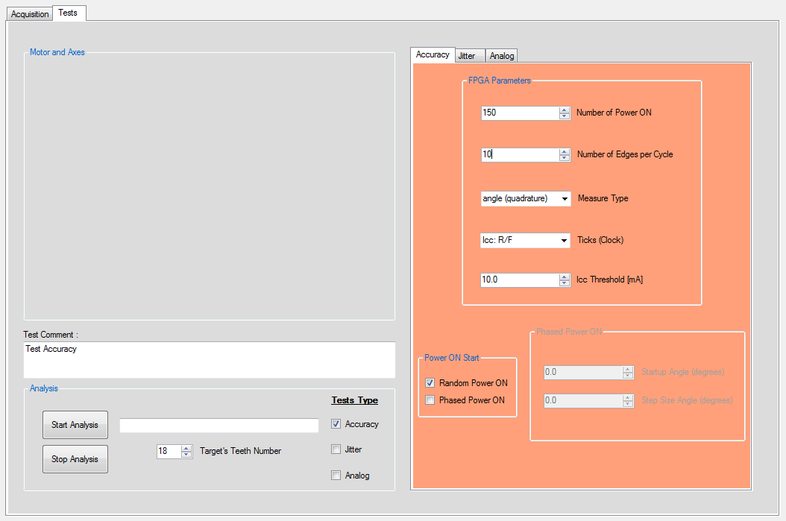
IV. AutoTests/FPGA Interface
IV.1 Tests interface
20/06/2016
20

Slide 35
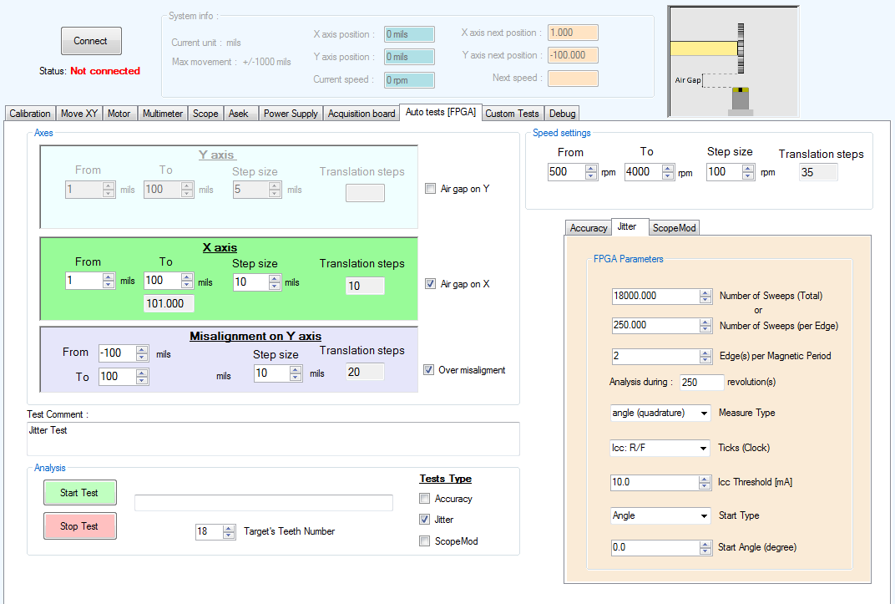
IV. AutoTests/FPGA Interface
20/06/2016
24

Slide 36


V. Conclusion
Project review :
Automatic and manual tests
Acquisition Control independent
Jitter and Startup Accuracy Test
Ready to be integrated
Acquisition functions flexibility
All functions tested
20/06/2016
25

Slide 37
V. Conclusion
Possible upgrades :
Create a script
Mapping Tab
Phased PowerOn for Startup Accuracy
Verified all functionalities
Update “Previous Settings” function
20/06/2016
26

Slide 38
V. Conclusion
Thanks to :
Allegro MicroSystems Europe
The complete Allegro Team
Internship Supervisor : Loïc Messier
Université Savoie Mont-Blanc
IUT d’Annecy-le-Vieux & its GEII department
Teacher : Stephane Bertrand
20/06/2016
27

Slide 39

Thank you for listening
Questions ?
20/06/2016
28

Slide 40
Thank you for listening
Questions ?
20/06/2016
28

